Slide 1

CS-M151B
Computer Systems Architecture
Blaise Tine
UCLA Computer Science

Slide 2

Attendance

Slide 3
Agenda
Precise exceptions
Caches

Slide 4

Exceptions
What is exception?
Unusual or unexpected program event.
A system service is takes action to handle the event
User program
System exception handler
Notes:
Instr window = range of instructions to search

Slide 5
S/W Exceptions
Software exceptions are user-level unusual events
Defined by the programing language
User program
SW exception handler
Notes:
Instr window = range of instructions to search

Slide 6
S/W Exceptions
Software exceptions triggers
Hardware: try { z = y / x; } catch
Software: if (x == 0) => throw
User program
Exception handler
Notes:
Instr window = range of instructions to search

Slide 7
Interrupts vs Exceptions
Interrupts
Cased by external events
e.g. network, keyboard, timer
Asynchronous to program execution
May be handled between instructions
Simply suspend and resume user program
Notes:
Instr window = range of instructions to search

Slide 8
Interrupts vs Exceptions
Exceptions
Caused by internal events
Synchronous to program execution
Condition must be remedied by the handler
Program may resume or abort
Notes:
Instr window = range of instructions to search

Slide 9
Question
Which RISC-V instructions can execute without exceptions?
Notes:
Instr window = range of instructions to search

Slide 10
Types of Exceptions
Arithmetic
Overflow, undeflow
Division by zero
Faults
Page fault
Invalid opcode
Errors
Parity
Traps
Breakpoint
Notes:
Instr window = range of instructions to search

Slide 11
Precise Exceptions
What supporting precise exceptions entails?
All previous instructions have been executed.
All following instructions have not been modified the process state
The faulting instruction may or may not have been executed, depending on the definition of the architecture and the cause of the exception.
Notes:
Instr window = range of instructions to search

Slide 12
Exceptions in in-order pipeline
Ifetch
Reg
DMem
Reg
ALU
Load
Div
Load
Div
Load
Exception
Div
Load
Load
Notes:
Instr window = range of instructions to search

Slide 13
Exceptions in out-of-order pipeline
What happens if a speculatively executed instruction faults?
A
A
B
B
Branch mispred
A, B Commit
C
C
W
D
D
X
E
Divide by Zero!
E
Divide by Zero!
Outside world sees: A, B, fault!
Fault should never be seen!
Should have been: A, B, C, D, fault!
Notes:
Instr window = range of instructions to search

Slide 14
Solution: handle faults like other results
ROB commits instructions to register file when
It is oldest for in-order state update
It is known to be non-speculative
Do the same with faults!
At exec, make note of any faults, but don’t expose to outside world
If the instruction gets to commit, then expose the fault

Slide 15
Example
(commit)
Resolved
Miss
E
C
F
A
LOAD R1 = 0[R2]
LOAD
P1
imm
R2
X
X
B
ADD R3 = R1 + R4
ADD
P2
P1
R4
X
X
C
SUB R1 = R5 – R6
SUB
P3
R5
R6
X
X
D
DIV R4 = R7 / R1
DIV
P4
R7
P3
X
X
X
E
LOAD R6 = 0[R7]
LOAD
P5
imm
R7
X
X
X
Fault!
(3 commits)
Now raise fault
Divide by zero
Flush rest of ROB,
Start fetching
Fault handler
Fault deferred until architecturally correct point.
Other fault “never happened”!
Notes:
E => execute
C => complete
F => faulted

Slide 16
Caches

Slide 17
Memory Latency is Long
60-100ns is common
What this really means for the CPU in term of clock cycles?
Assume 2 GHz CPU
Clock cycle time? = 0.5ns
100ns memory → 200 cycle memory latency!

Slide 18
Memory Latency is Long
Why is accessing memory slow?
Storage technology
(DRAM) is slower (row buffer refreshes, DRAM cells) than SRAM
Physical distance
Usually outside the core, sharing of the memory by multiple cores and peripherals (hard-drive)
Bus bandwidth
Growing number of cores saturate the memory bus

Slide 19
Memory Latency is Long
Solution: hardware caches

Slide 20
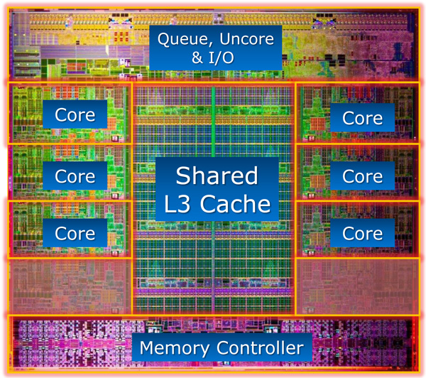
Today’s caches occupy a large die area
Intel Sandy Bridge (2011) - 6x L1-D: 64 KB - 6x L1-I: 64 KB
- 6x L2: 256 KB - 1x L3: 20,480 KB (20 MB)

Slide 21
Storage Hierarchy and Locality
Capacity +
Speed -
Disk
SRAM Cache
Main Memory
Row buffer
L3 Cache
L2 Cache
ITLB
ICache
DCache
DTLB
Scratchpad
Register File
Speed +
Capacity -

Slide 22
Data Locality
Temporal Locality
If data item needed now, it is likely to be needed again in near future
Spatial Locality
If data item needed now, nearby data likely to be needed in near future

Slide 23
Locality with caches
Exploiting Temporal locality
Keep recently used data in fast memory close to the processor
Hierarchy
Replacement policies
Exploiting spatial locality
Also bring nearby data close
Block size
Cache size

Slide 24
Review Questions
Memory addresses A, A+1, A+2, A+3, A+4
Spatial locality or temporal locality?
Spatial
Memory addresses A,B,C,A,B,C,A,B,C
Spatial locality or temporal locality?
Temporal

Slide 25
Locality and caches
Solution: hardware caches

Slide 26
Cache Basics
Fast (but small) memory close to processor
When data referenced
If in cache, use cache instead of memory
If not in cache, bring into cache (actually, bring entire block of data, too)
Maybe have to kick something else out to do it!
Key: Optimize the
average memory
access latency

Slide 27
Cache Basics
Important decisions
Placement: where in the cache can a block go?
Identification: how do we find a block in cache?
Replacement: what to kick out to make room in cache?
Write policy: what do we do about stores?

Slide 28
Cache Basics
Cache consists of block-sized lines
Line size typically power of two
Why?
Typically 16 to 128 bytes in size
Why?
MSB
LSB
Block size
Notes:
Power of two => addressing efficiency, memory alignment
Block size=> memory transfer efficiency, miss penalty, memory architecture

Slide 29
Cache Basics
Example
Suppose cache block size is 128 bytes
Read data at address A=0x7fffa3f4
What is the block base address?
Answer: 0x7fffa380

Slide 30
Cache Basics
Example
Suppose cache block size is 64 bytes
Lowest 6 bits determine offset within block
What do we use the offset for?
Answer: Access to CPU data (e.g. 4 bytes - 32-bit)

Slide 31
Cache Placement
Placement
Where to place a memory block in cache lines?
Placement Policies
Direct mapped (block can go to only one line)
Index the cache using memory address
Fully Associative (block can go to any line)
Lookup the cache using tag
Set-associative (block can go to one of N lines)
Mixing indexing and lookup

Slide 32
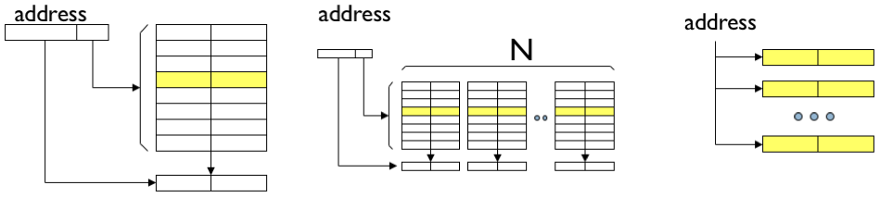
Cache Placement
Direct Mapped
Fast access (indexing)
block A can only be stored in one location
No search
Has block conflicts

Slide 33
Cache Placement
Fully Associative
Slow access (lookup)
Compare address with each tag
Block A can be stored in any cache line
Expensive search
No block conflicts

Slide 34
Cache Placement
Set Associative
Average access (indexing + lookup)
Compare address with N tags
Block A can be stored in exactly one set but in any cache line in the set
Less block conflicts

Slide 35
Cache Identification
When address referenced, need to
Find whether its data is in the cache
If it is, find where in the cache
This is called a cache lookup
Each cache line must have
A valid bit (1 if line has data, 0 if line empty)
We also say the cache line is valid or invalid
A tag to identify which block is in the line (if line is valid)

Slide 36
Cache Address
MSB
LSB
Data
address
TAG
Index
Offset
Offset: Byte offset in block
Index: Which set in the cache is the block located
Tag: Need to match address tag in cache
Set: Group of blocks corresponding to same index

Slide 37
Cache Indexing
dex
TAG
Index
Block offset
TAG0
TAG2
DATA0
DATA1
=
=
Logic
YES
Data
HIT
YES

Slide 38
Tag Array
Any information related to cache other than data is stored in the tag storage.
Necessary: valid bit, tag bits
Also: dirty bits, replacement info, coherence info, atomic info, etc..

Slide 39
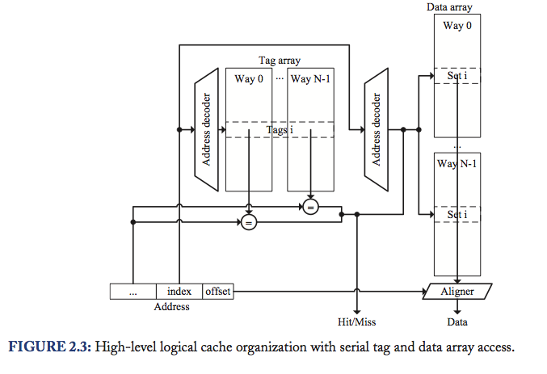
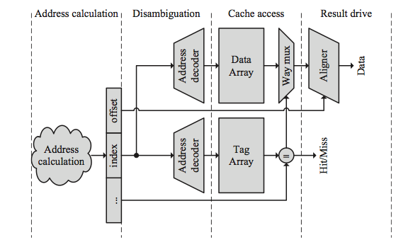
Parallel/Serial TAG and Data Array Access

Slide 40
Exercice
1%16 =1
4%16 = 4
8%16 =8
5%16 =5
20%16 = 4
17%16 = 1
19%16 =3
56%16 = 8
9%16 =9
11%16 =11
4%16 = 4
43 % 16 = 11
5%16 = 5 Hit
6%16 = 6
9%16 = 9 Hit
17%16 =1 Hit
0
1 | 1 17
2
3 | 19
4 | 4 20 4
5 | 5
6 | 6
7
8 | 8 56
9 | 9
10
11 | 11 43
12
13
14
15
Here is a series of address references given as word address: 1,4,8,5,20,17,19,56,9,11,4,43,5,6,9,17. Assuming a direct-mapped cache with 16 one-word blocks that is initially empty, label each reference in the list as a hit or miss and show the final contents of the cache.

Slide 41
Cache Replacement
Need a free line to insert new block
Which block should we kick out?
Several strategies
Random (randomly selected line)
FIFO (line that has been in cache the longest)
LRU (least recently used line)
LRU Approximations (Pseudo LRU)
Notes:
Pseudo LRU use a binary tree as optimization

Slide 42
Cache Replacement
Random Replacement
We care about speed!
Use a global incrementing counter
On replacement, use counter current value

Slide 43
Cache Replacement
LRU Replacement
Have LRU counter for each line in a set
When line accessed
Get old value X of its counter
Set its counter to max value
For every other line in the set
If counter larger than X, decrement it
When replacement needed
Select line whose counter is 0

Slide 44
Write Policy
Do we allocate cache lines on a write miss?
Write-allocate
A write miss brings block into cache
No-write-allocate
A write miss leaves cache as it was
Pros and cons?
Depends on temporal locality

Slide 45
Write Policy
Do we update memory on writes?
Write-through
Memory immediately updated on each write
Generally combined with no-write-allocate
Write-back
Memory updated when line replaced
Generally combined with write-allocate

Slide 46
Write Policy
Do we update memory on writes?
Write-through
Memory immediately updated on each write
Generally combined with no-write-allocate
Write-back
Memory updated when line replaced
Generally combined with write-allocate

Slide 47
Write through / Write back
PROC
CACHE
MEM
Write-through
PROC
CACHE
MEM
Write-back
replacement

Slide 48
Writeback Caches
Need a Dirty bit for each line (stored in the Tag!)
A dirty line has more recent data than memory
Need dirty bytes storage as well (optional)
Line starts as clean (not dirty)
Line becomes dirty on first write to it
Memory not updated yet, cache has the only up-to-date copy of data for a dirty line
Replacing a dirty line
Must write data back to memory (write-back)

Slide 49
Cache Performance
Miss rate
Fraction of memory accesses that miss in cache
Hit rate = 1 – miss rate
Miss penalty ~ cache access + memory latency
Average memory access time
AMAT = hit latency + miss rate * miss penalty
CPU runtime latency
CPUtime = CycleTime x (Cycles_{Exec} + Cycles_{MemoryStall})
Cycles_{MemoryStall} = CacheMisses x (MissLatency_{Total} – MissLatency_{Overlapped})

Slide 50
Improving Cache Performance
AMAT = hit time + miss rate * miss penalty
Reduce miss penalty
Reduce miss rate
Reduce hit time

Slide 51
Improving Cache Performance
Cycles_{MemoryStall} = CacheMisses x (MissLatency_{Total} – MissLatency_{Overlapped})
Increase overlapped miss latency
Increase memory level parallelism

Slide 52
Improving Cache Performance
Memory latency = 100 cycles
16KB cache, 3 cycle latency, 85% hit rate
What’s the baseline AMAT?
= 3+100*0.15 = 18 cycles
What’s the best way to reduce latency?
Smaller 8KB cache: 1 cycle latency, 75% hit rate
= 1+ 100*0.25 = 26 cycles
Larger 32KB cache: 4 cycle latency, 90% hit rate
= 4 + 100*0.1 = 14 cycles

Slide 53
Hiding Miss latency
Idea: overlap miss latency with useful work
Also called “latency hiding”
Non-blocking (Lockup-free) caches
A blocking cache services one access at a time
While miss serviced, other accesses blocked (wait)
Non-blocking caches remove this limitation
While miss serviced, can process other requests
Prefetching
Predict what will be needed and get it ahead of time

Slide 54
Q&A

Slide 55
Acknowledgement
This course is partly inspired and use materials from the following courses created by my colleagues:
ECE-M1126C: Nader Sehatbakhsh @ UCLA
CS3220: Hyesoon Kim @ gatech

